Slide 1
UI AND UX
MOHAMED IBURAHIM
BSC AI AND ML

Slide 2
What is UI
DEFINITION:
Simple Layout: Clean tabs at the bottom (Games, Apps, Search)
Visuals Cards: Big buttons, clear pictures, and rounded boxes that highlight popular or recommended apps
Dark Mode: A Dark background option to make reading easier at night and save phone battery
EXAMPLE: The bright green "install" button an app page

Slide 3
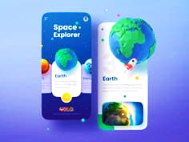
Image UI:

Slide 4
WHAT IS UX
DEFINITION:
SEARCH: Users can easily search for apps and games
EASY INSTALLATION: user can install with asimple tap
UPDATES: show available apps at one place
NAVIGATION: Catogories and menus make it easy to move around
the store

Slide 5
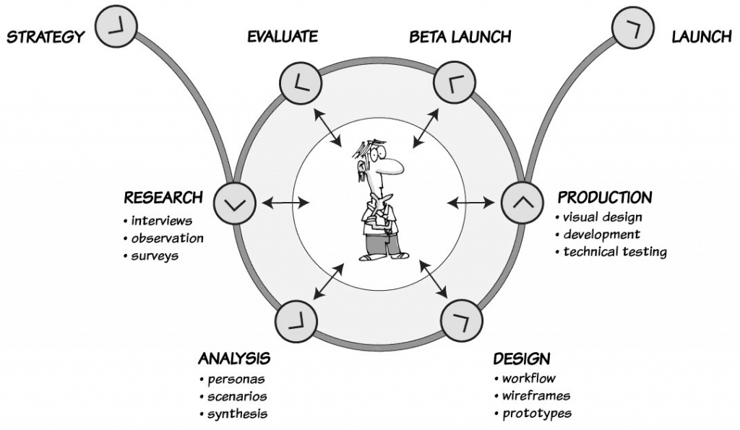
Image UX:
This Photo by Unknown Author is licensed under CC BY-ND

Slide 6
DIFFERENCE BETWEEN UI and UX:
UI
User interface
How an app look
Colors,buttons,icons
Focusses on visual design
Example: play stores button
design
UX
USER EXPERIENCE
How an app feels and works
Ease of use , Navigation , speed , convenience
Focuses on uder experience
Example : How easily you can find and install an app

Slide 7
THANK YOU!
INTRODUCTION OF UI AND UX

